Slide 1
String Manipulation
Tutorial #25

Slide 2
OBJECTIVE

Slide 3
Objective
The objective here is to walk away understanding the complexity of strings and how to make them work for you.

Slide 4
TEXTPLANATION

Slide 5
Textplanation
A string is an object.

Slide 6
Textplanation
If you think about it, a string does not hold a single value. It is a list of characters, strung together.

Slide 7
Textplanation
In addition, the characters are indexed, which means that each character has a specific spot in the string and that spot has a place number.
0 | 1 | 2 | 3 | 4
H | e | l | l | o

Slide 8
Textplanation
The indices of a string begin at 0. Just about all indexing in computer programming begins with the number 0.
0 | 1 | 2 | 3 | 4
H | e | l | l | o

Slide 9
Textplanation
The result is that the last index will always be 1 less than the length of the string..
0 | 1 | 2 | 3 | 4
H | e | l | l | o

Slide 10
Textplanation
What all of this means is that strings can be manipulated through the use of the functions that belong to them.

Slide 11
Textplanation
Function/Property | Description
length | Gives the number of characters in a string
charAt(idx) | Returns the character at the specified index.
charCodeAt(idx) | Returns a number indicating the Unicode value of the character at the given index.
indexOf(str) | Returns the index within the calling String object of the first occurrence of the specified value, or -1 if not found.
lastIndexOf(str) | Returns the index within the calling String object of the last occurrence of the specified value, or -1 if not found.
substr(start, length) | Returns the characters in a string beginning at the specified location through the specified number of characters (or to the end).
substring(start, end) | Returns the characters in a string between two indexes into the string.
toLowerCase() | Returns the calling string value converted to lower case.
toUpperCase() | Returns the calling string value converted to uppercase.

Slide 12
CONSTRUCTION

Slide 13
Construction
Create a folder somewhere on your drive and label it Strings.
Open up notepad++.
Save the empty file to your folder and name the file “index.html”.
All first pages on a website are called index.
As you go through the images of the construction, add to your code. You will see comments with explanations of what you are doing. Those comments will change with each slide. You should not type my comments into your code.
We’ll be constructing a page that lets the user type in some information and then save it to a log. The log will be ongoing and will ultimately validate the entries.

Slide 14
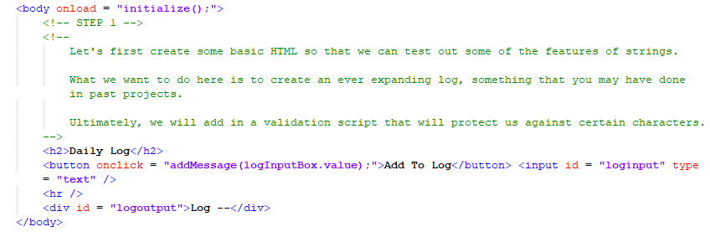
Construction

Slide 15
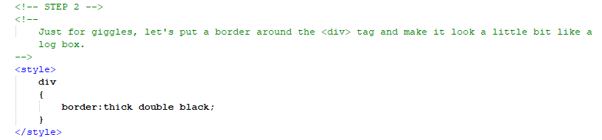
Construction

Slide 16
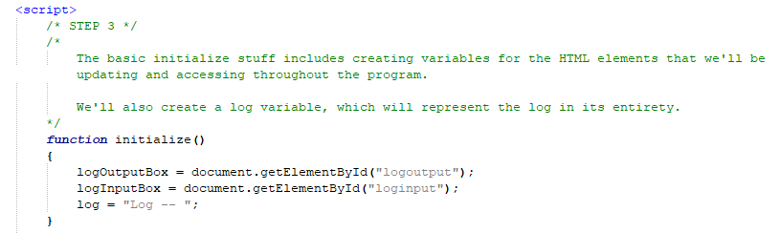
Construction

Slide 17
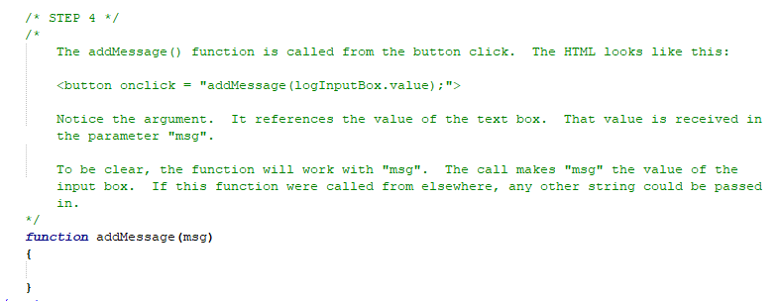
Construction

Slide 18
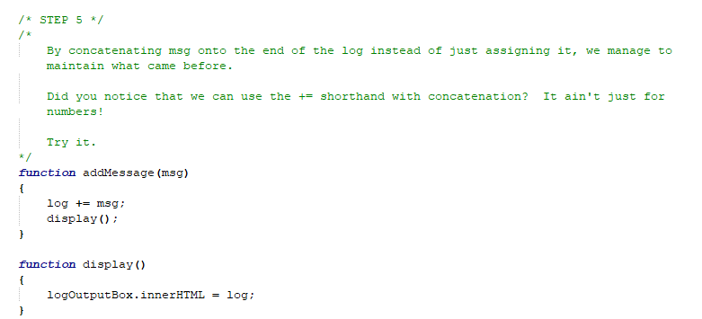
Construction

Slide 19
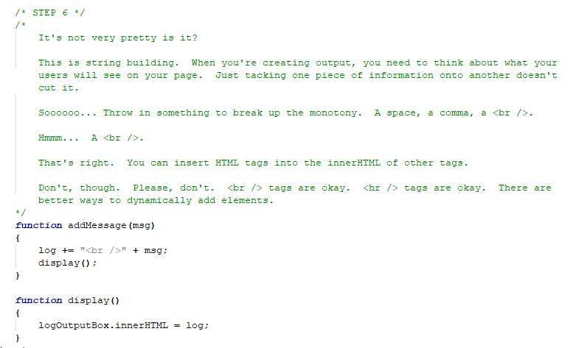
Construction

Slide 20
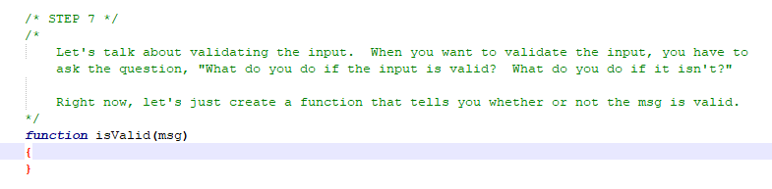
Construction

Slide 21
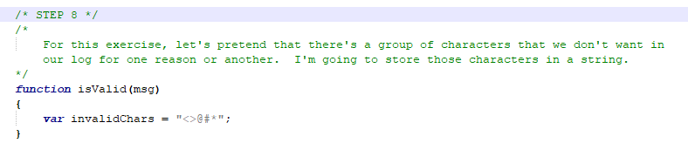
Construction

Slide 22
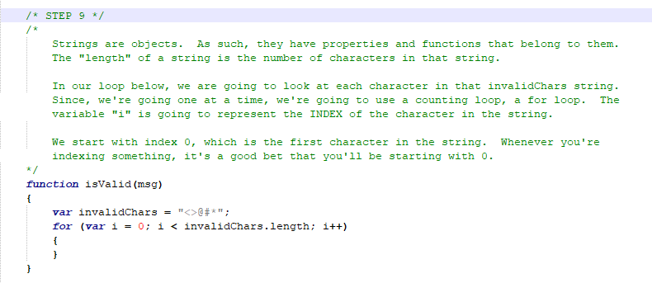
Construction

Slide 23
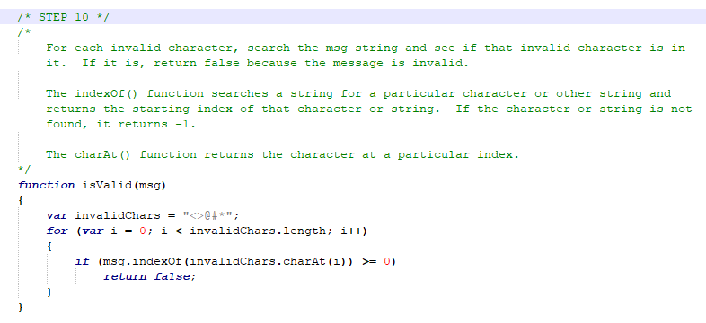
Construction

Slide 24
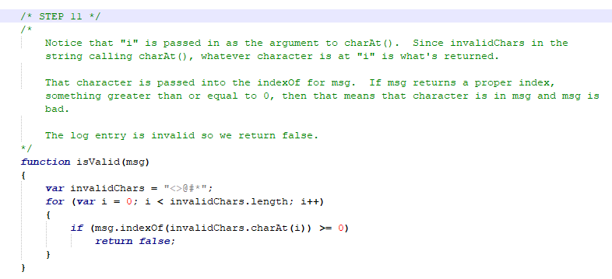
Construction

Slide 25
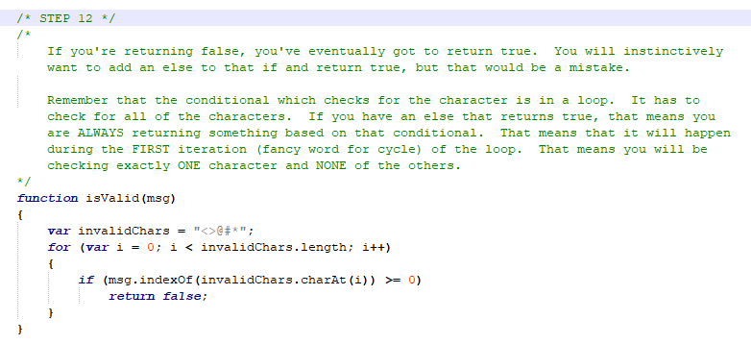
Construction

Slide 26
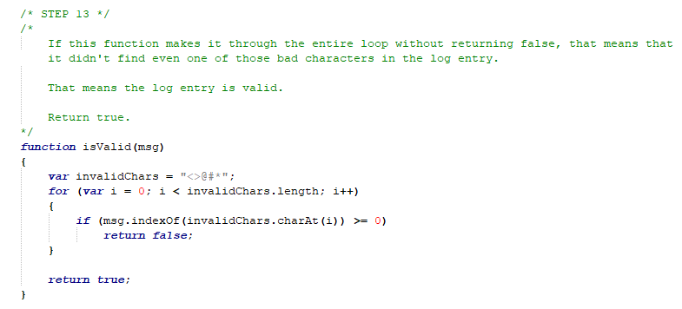
Construction

Slide 27
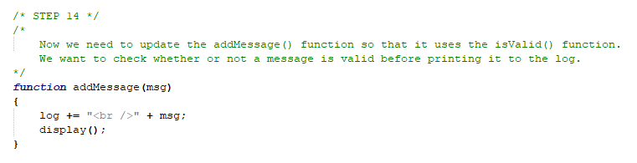
Construction

Slide 28
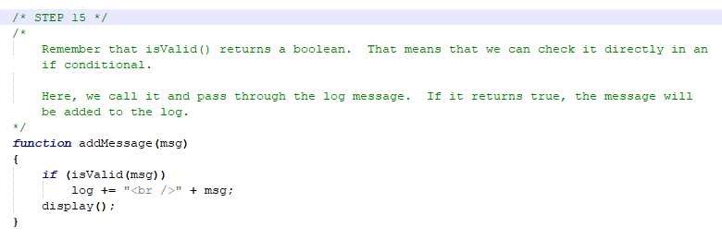
Construction

Slide 29
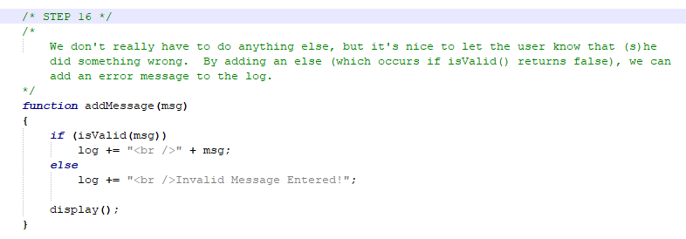
Construction

Slide 30
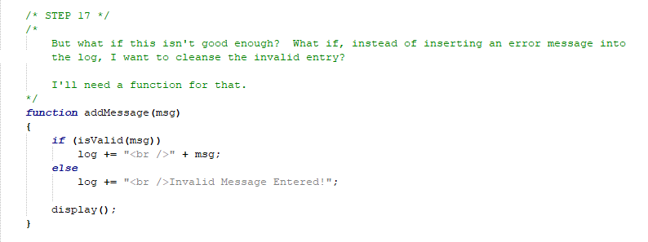
Construction

Slide 31
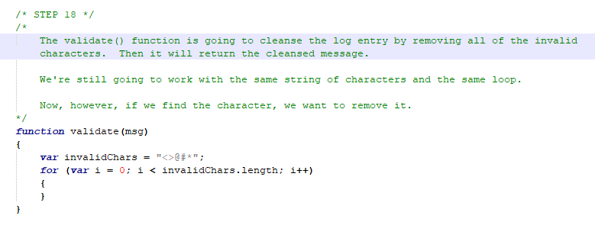
Construction

Slide 32
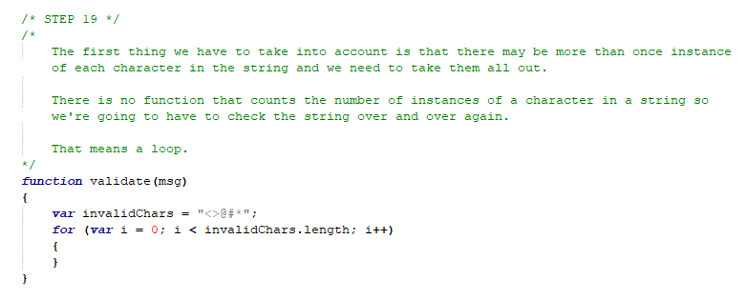
Construction

Slide 33
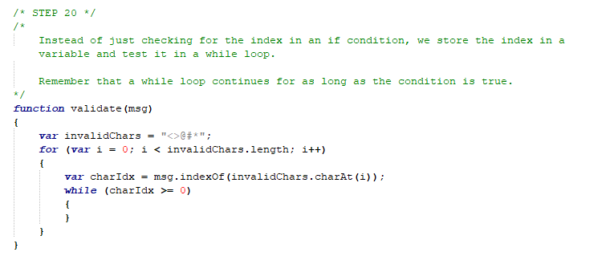
Construction

Slide 34
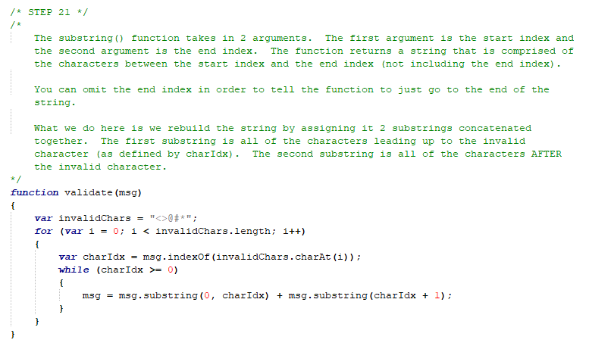
Construction

Slide 35
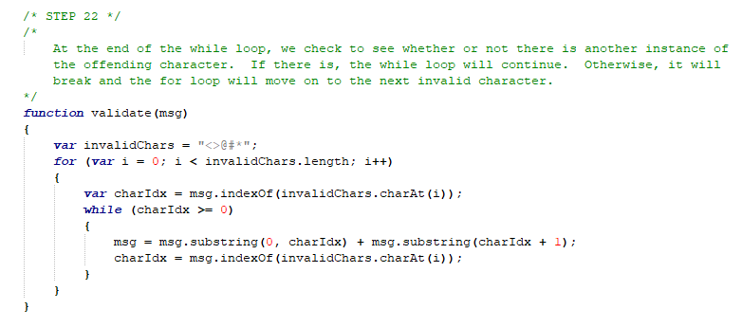
Construction

Slide 36
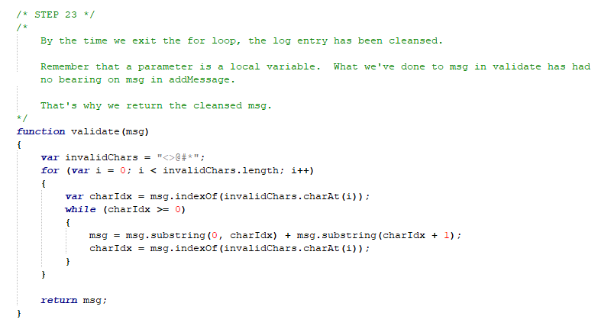
Construction

Slide 37
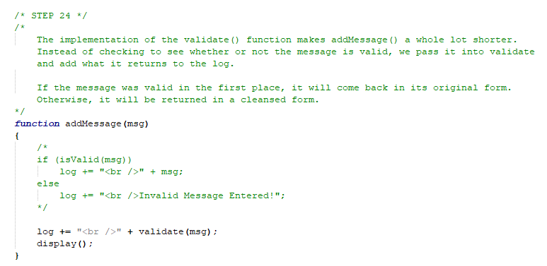
Construction

Slide 38
A DEEPER MEANING

Slide 39
A Deeper Meaning
I may have said this before, but everything in your code starts out as a string. Browsers are smart enough to recognize a number or a boolean value when it’s explicitly defined in your code, but it’s hit or miss at other times, especially when it comes to input boxes or data retrieval. So, the lesson to be learned here is that you should always assume something is a string unless you, as the programmer, stated that it is not.

Slide 40
A Deeper Meaning
With that being a fact of your existence, you absolutely need to understand how to work with strings. They are used in all software landscapes and, conceptually, they are consistent across platforms. Master them here and you will have mastered them everywhere.

Slide 41
FAQ

Slide 42
FAQ
Since everything is a string, should I just make everything a string?
No. You can't perform arithmetic operations on strings. If you're constantly converting, that’s extra work for the processor. One of the hardest things to learn as a new programmer is how to represent your information as variables. A lot of it is abstract. If you look for a magic solution, like make everything a string, you'll find it very difficult to program around the situations that don't fit your mold.

Slide 43
FAQ
Why doesn’t toUpperCase() work?
Strings have many functions that alter, but don’t alter the string. The best examples of these are toUpperCase() and toLowerCase(). These functions claim to convert the string to all caps or all lowercase letters. In fact, inside of these functions, a temporary duplicate string is created, altered, and returned, leaving the original string intact. If you want to alter your original string, you would set it equal to the function call.
myStr = myStr.toUpperCase();

Slide 44
ACTIVITY

Slide 45
The Dillz
The great explorer, Garth Garretson, has discovered a new tribe of people in the Amazon Jungle. They call themselves the Dillz. At first, he had a lot of trouble understanding them until he realized that their language is just a form of English with the letters illz inserted at certain points. Now, armed with that information, he can translate their writings as well as communicate directly with them.

Slide 46
The Dillz
Create a page that can translate some text from Dillz to English and English to Dillz. The Dillz insert the letters illz before every vowel or vowel blend in every word so that the word baby would translate to billzaby and the word about would translate to illzabillzout.
So that Garth Garretson can translate quickly, he will be typing phrases into a text box and reading the output on screen. The program will know whether the phrase is in English or Dillz and translate accordingly (there is no English word with the letter sequence illz).
The Dillz do not consider y a vowel under any circumstances. They also do not consider an e at the end of a word to be a vowel.

Slide 47
The Dillz
Sample Input
Good Morning, Mr. Garretson.
Illzit’s illza billzeautillzifillzul dillzay.
Whillzat willzould yillzou lillzike tillzo dillzo tillzodillzay?
Sample Output
Gillzood Millzornillzing, Mr. Gillzarrillzetsillzon.
It’s a beautiful day.
What would you like to do today?

